Slide 1
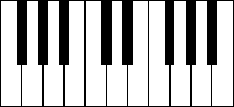
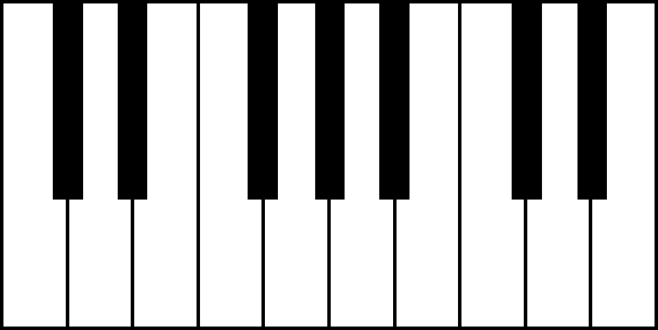
Klavier-Akkorde
 | Dur | Moll
A
B
C
D
E
F
G
Ab G#
Bb A#
Db C#
Eb D#
Gb F#
CC BY-SA zebis.ch

Slide 2
Piano Tastatur

