Slide 1
A treasure hunt reading game
Welcome to this reading activity. This is how it works:
Start the Powerpoint presentation.
Read the texts and look at the picture.
Find the right number and klick on it. If you are correct, the story goes on. If not, you need to go back and read again.
Have fun and enjoy the story!
Let’s start.

Slide 2
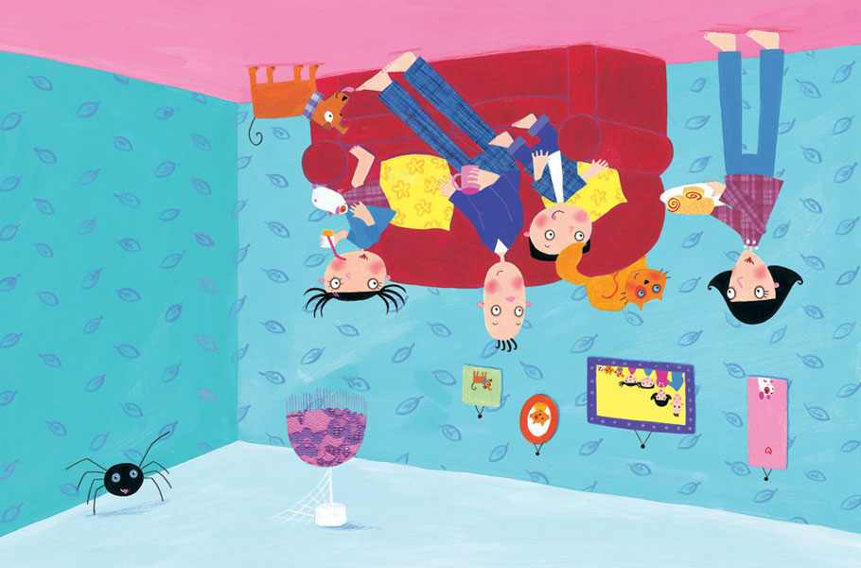
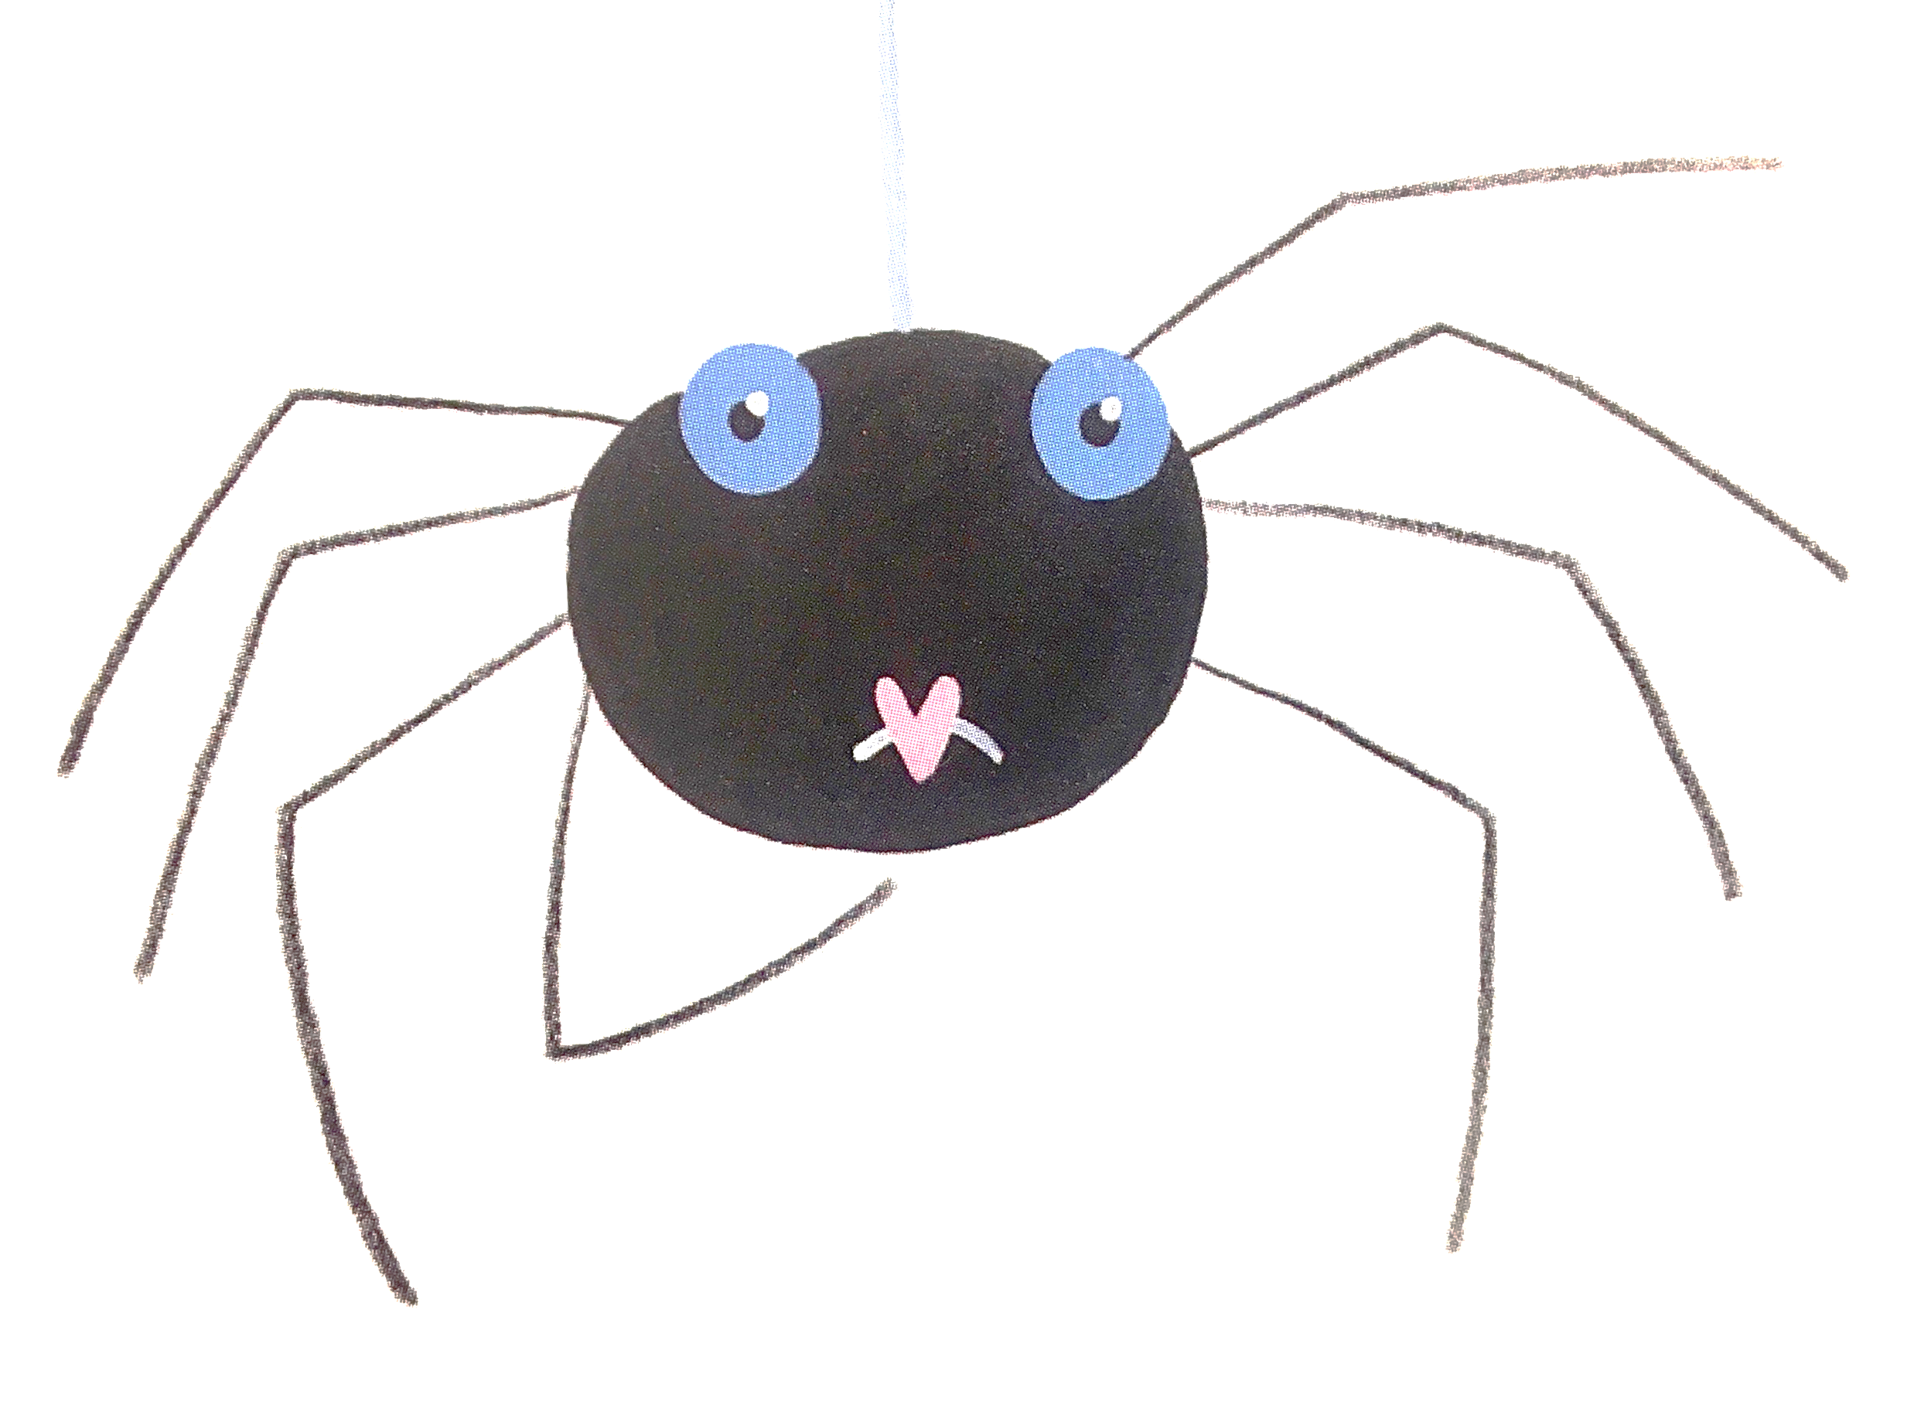
This little spider lives in a house.
The spider wants to be a pet of the family.
Find a pet of the family
B
A

Slide 3
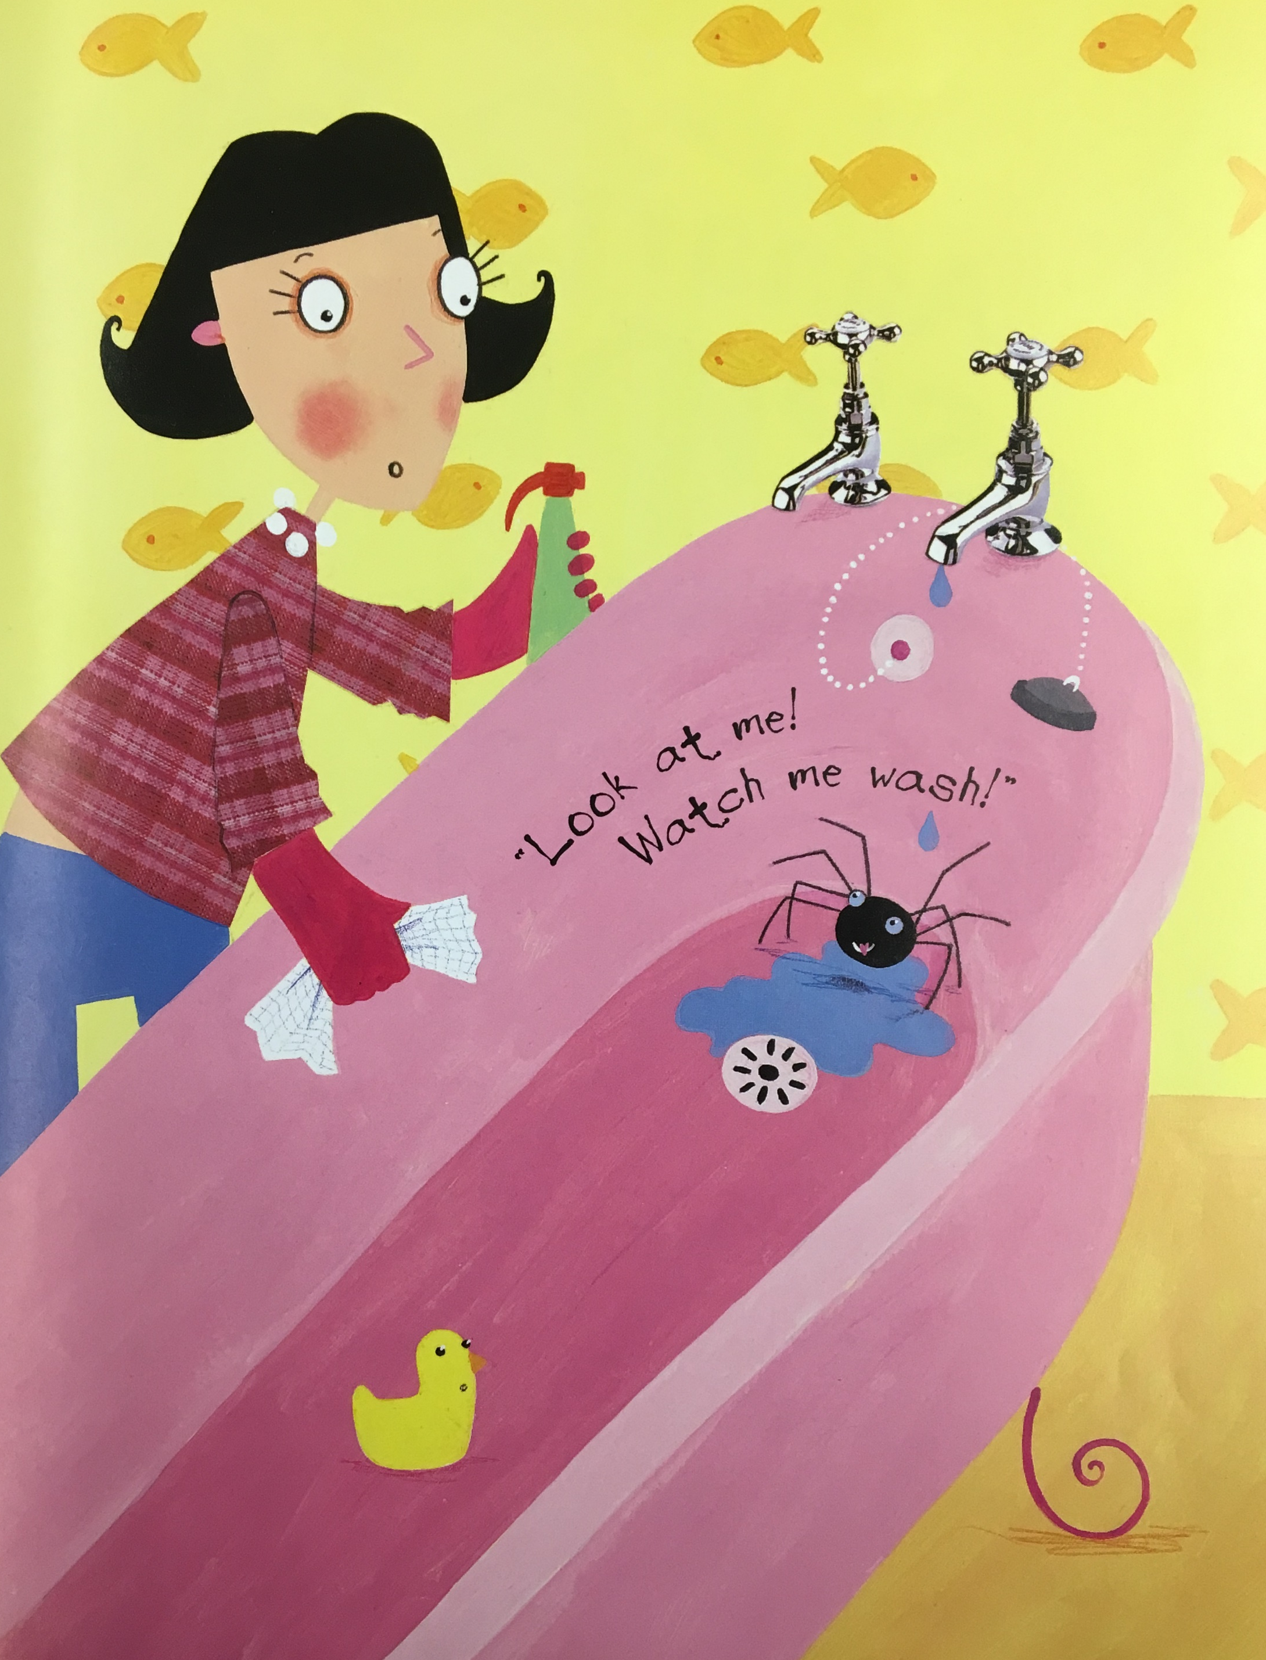
So it goes into the bathtub and washes himself.
Find the spider.
B
A

Slide 4
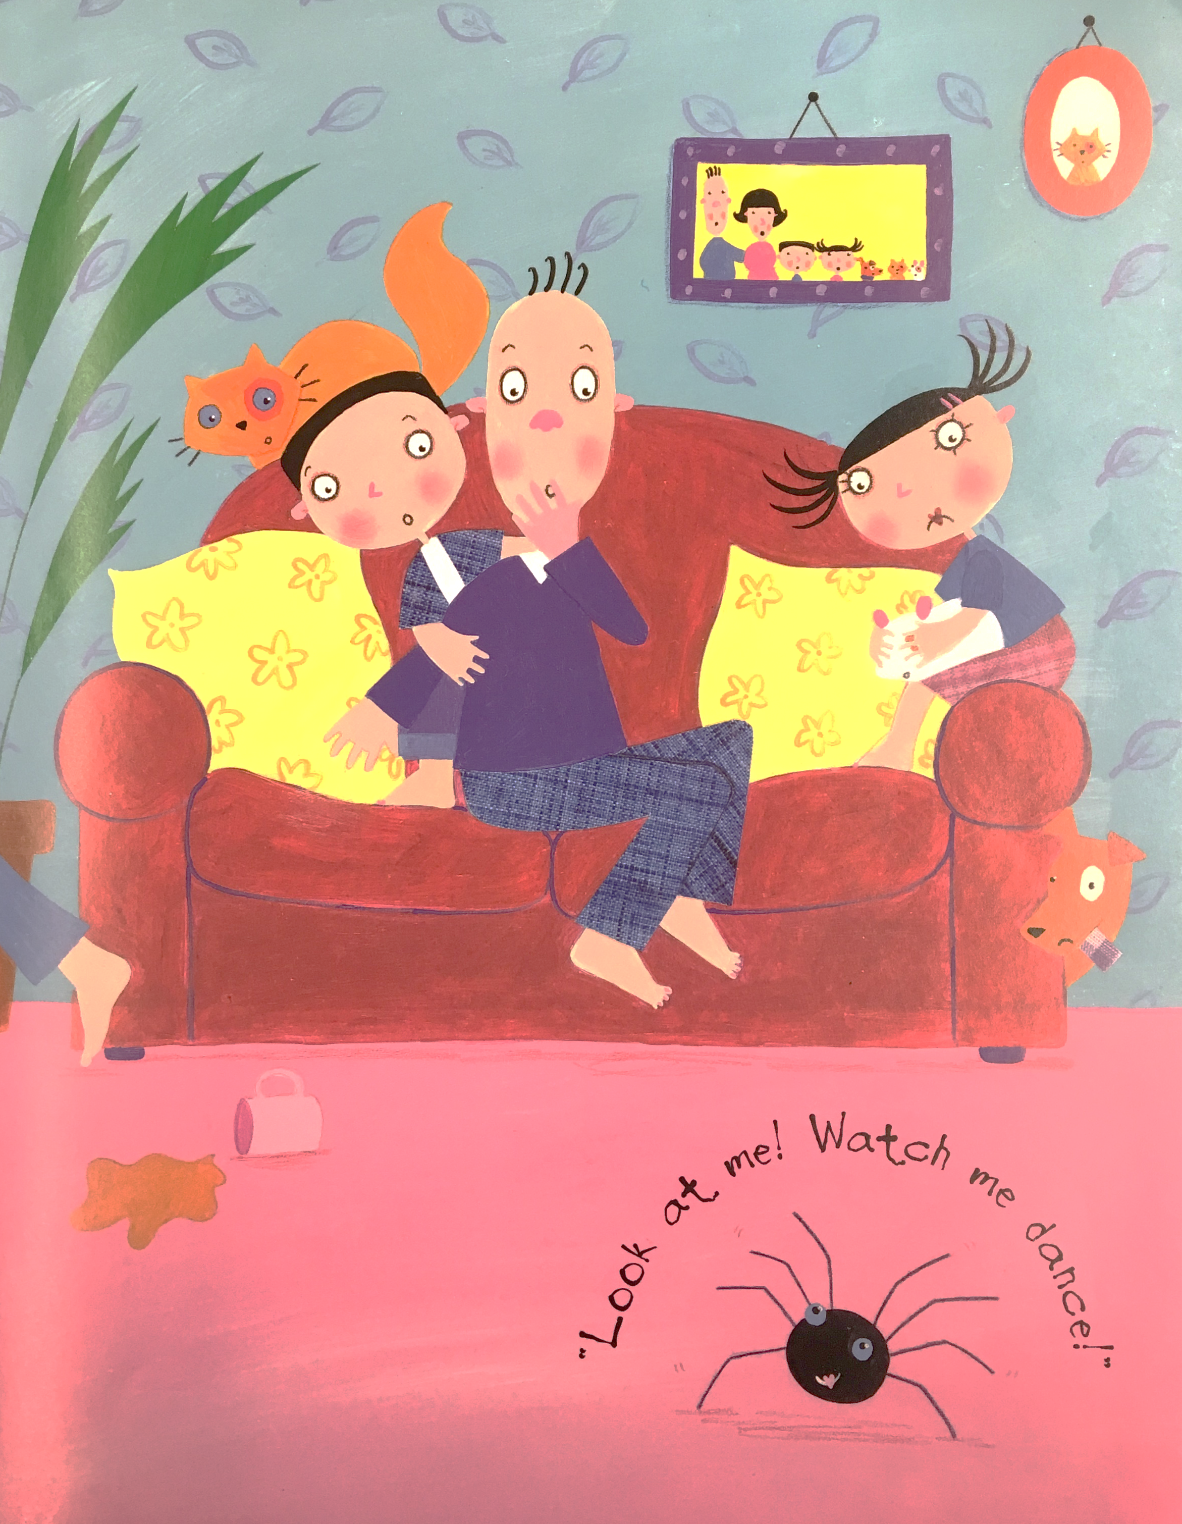
Because the spider wants to be a pet, it wants to show the family that it can do things their pets can’t do.
The spider shows them that…
…it can bark! …it can dance!
A
B

Slide 5
After they put the spider out, it wonders what to do next.
The spider sees the dog play in the garden and has an idea. The spider wants to… …show them that
it can wash itself! …play with the dog!
A
B

Slide 6
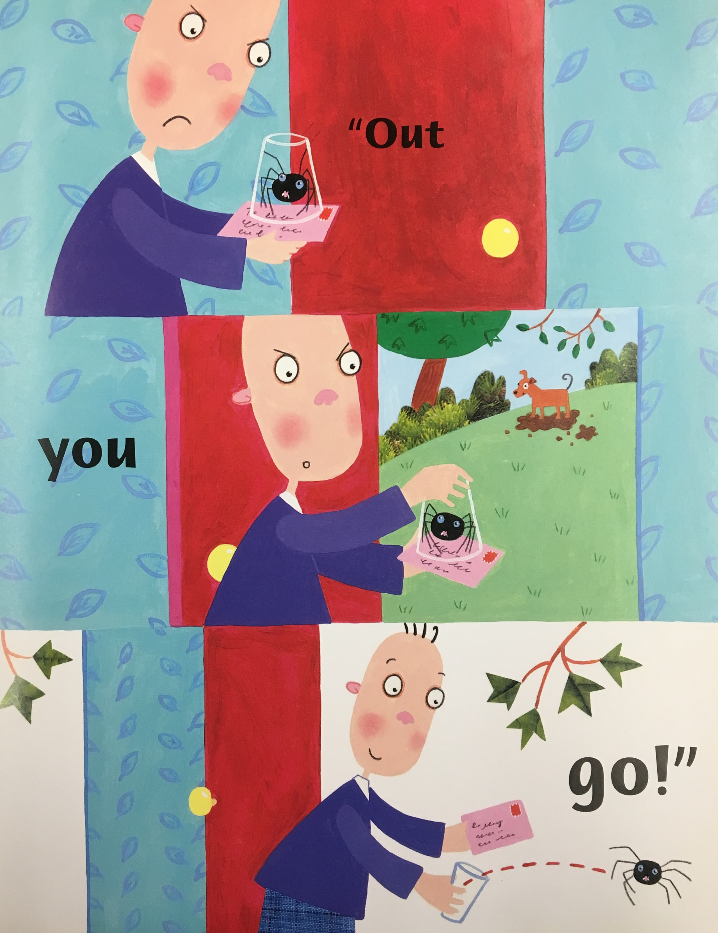
But the family is afraid of the spider.
They take the spider out to the garden.
Find the garden in the picture.
A
B

Slide 7
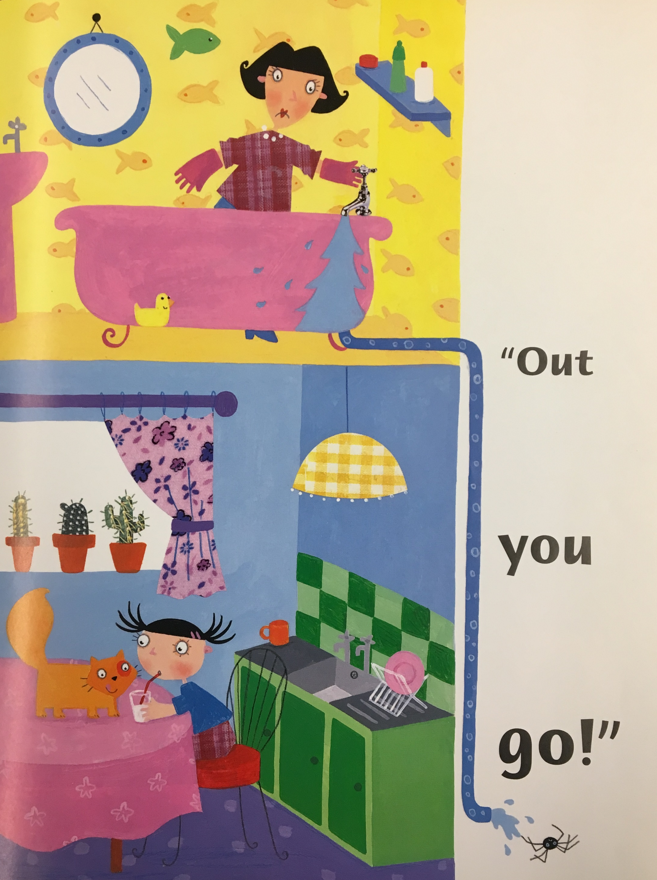
But the family is still scared of the spider.
They don’t want it in the house.
The mother… …does nothing. …flushes him out.
A
B

Slide 8
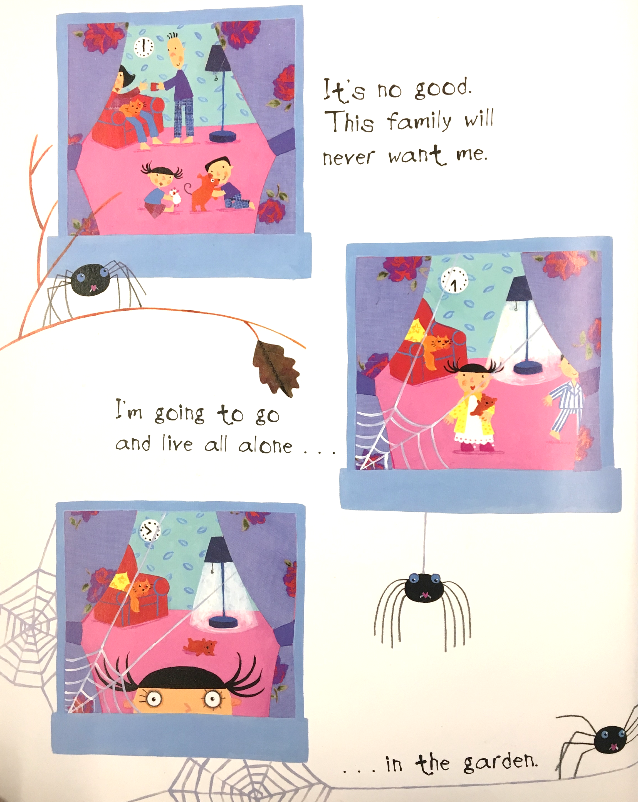
But the family still doesn’t want the spider.
Where does the spider decide to go?
To live all alone in the garden.
To another country.
A
B

Slide 9
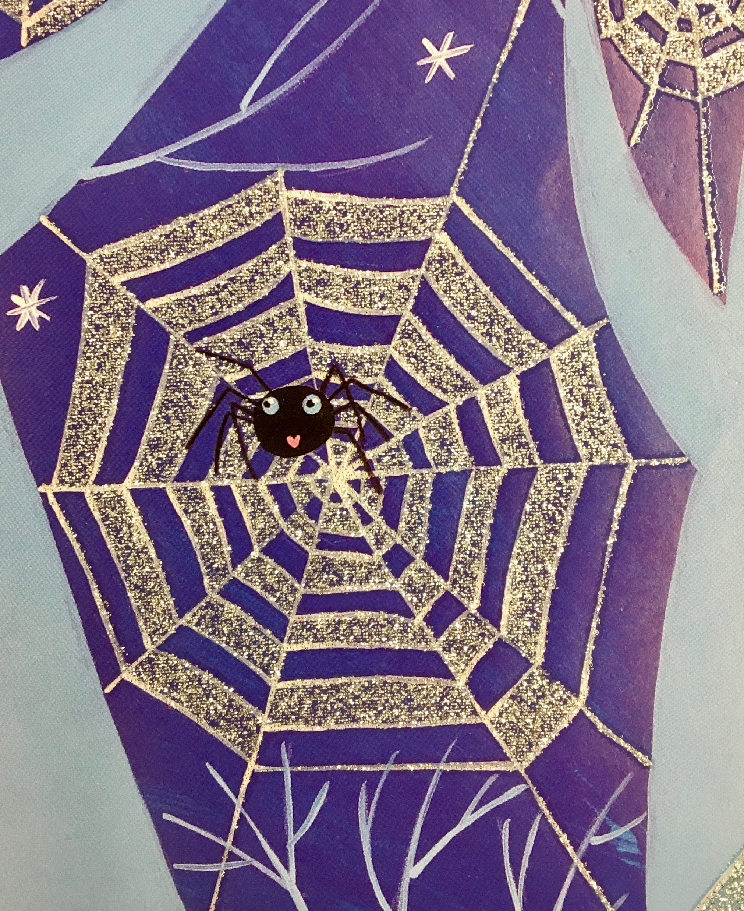
A
The family wants to make the spider their pet.
The spider is very happy.
Where is the spider?
B

Slide 10
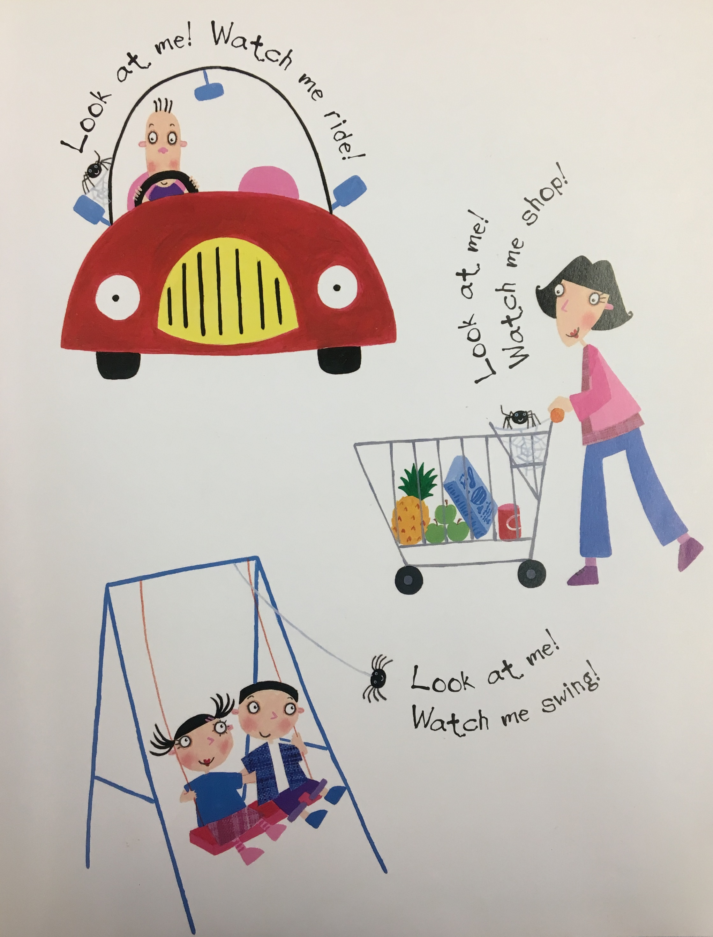
A
Now that the spider is a pet, it can do many fun things. Find the spider in the car.
B

Slide 11
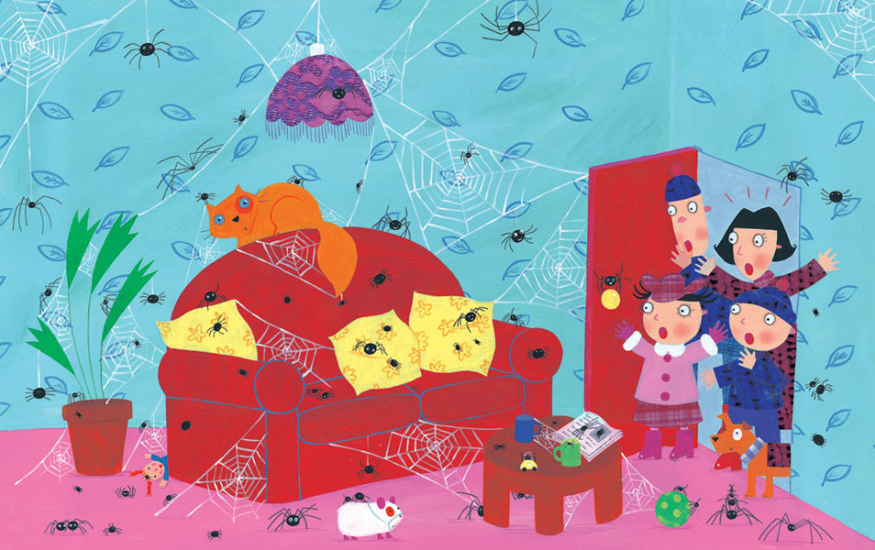
A
B

Slide 12
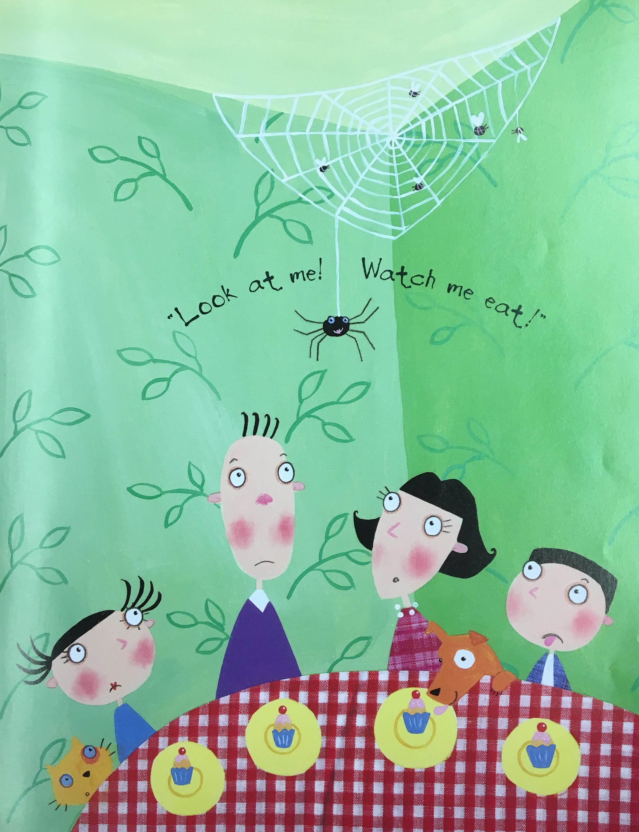
B
After that, the spider wants to show them how easy it is to look after.
Where is the food of the spider?
A

Slide 13
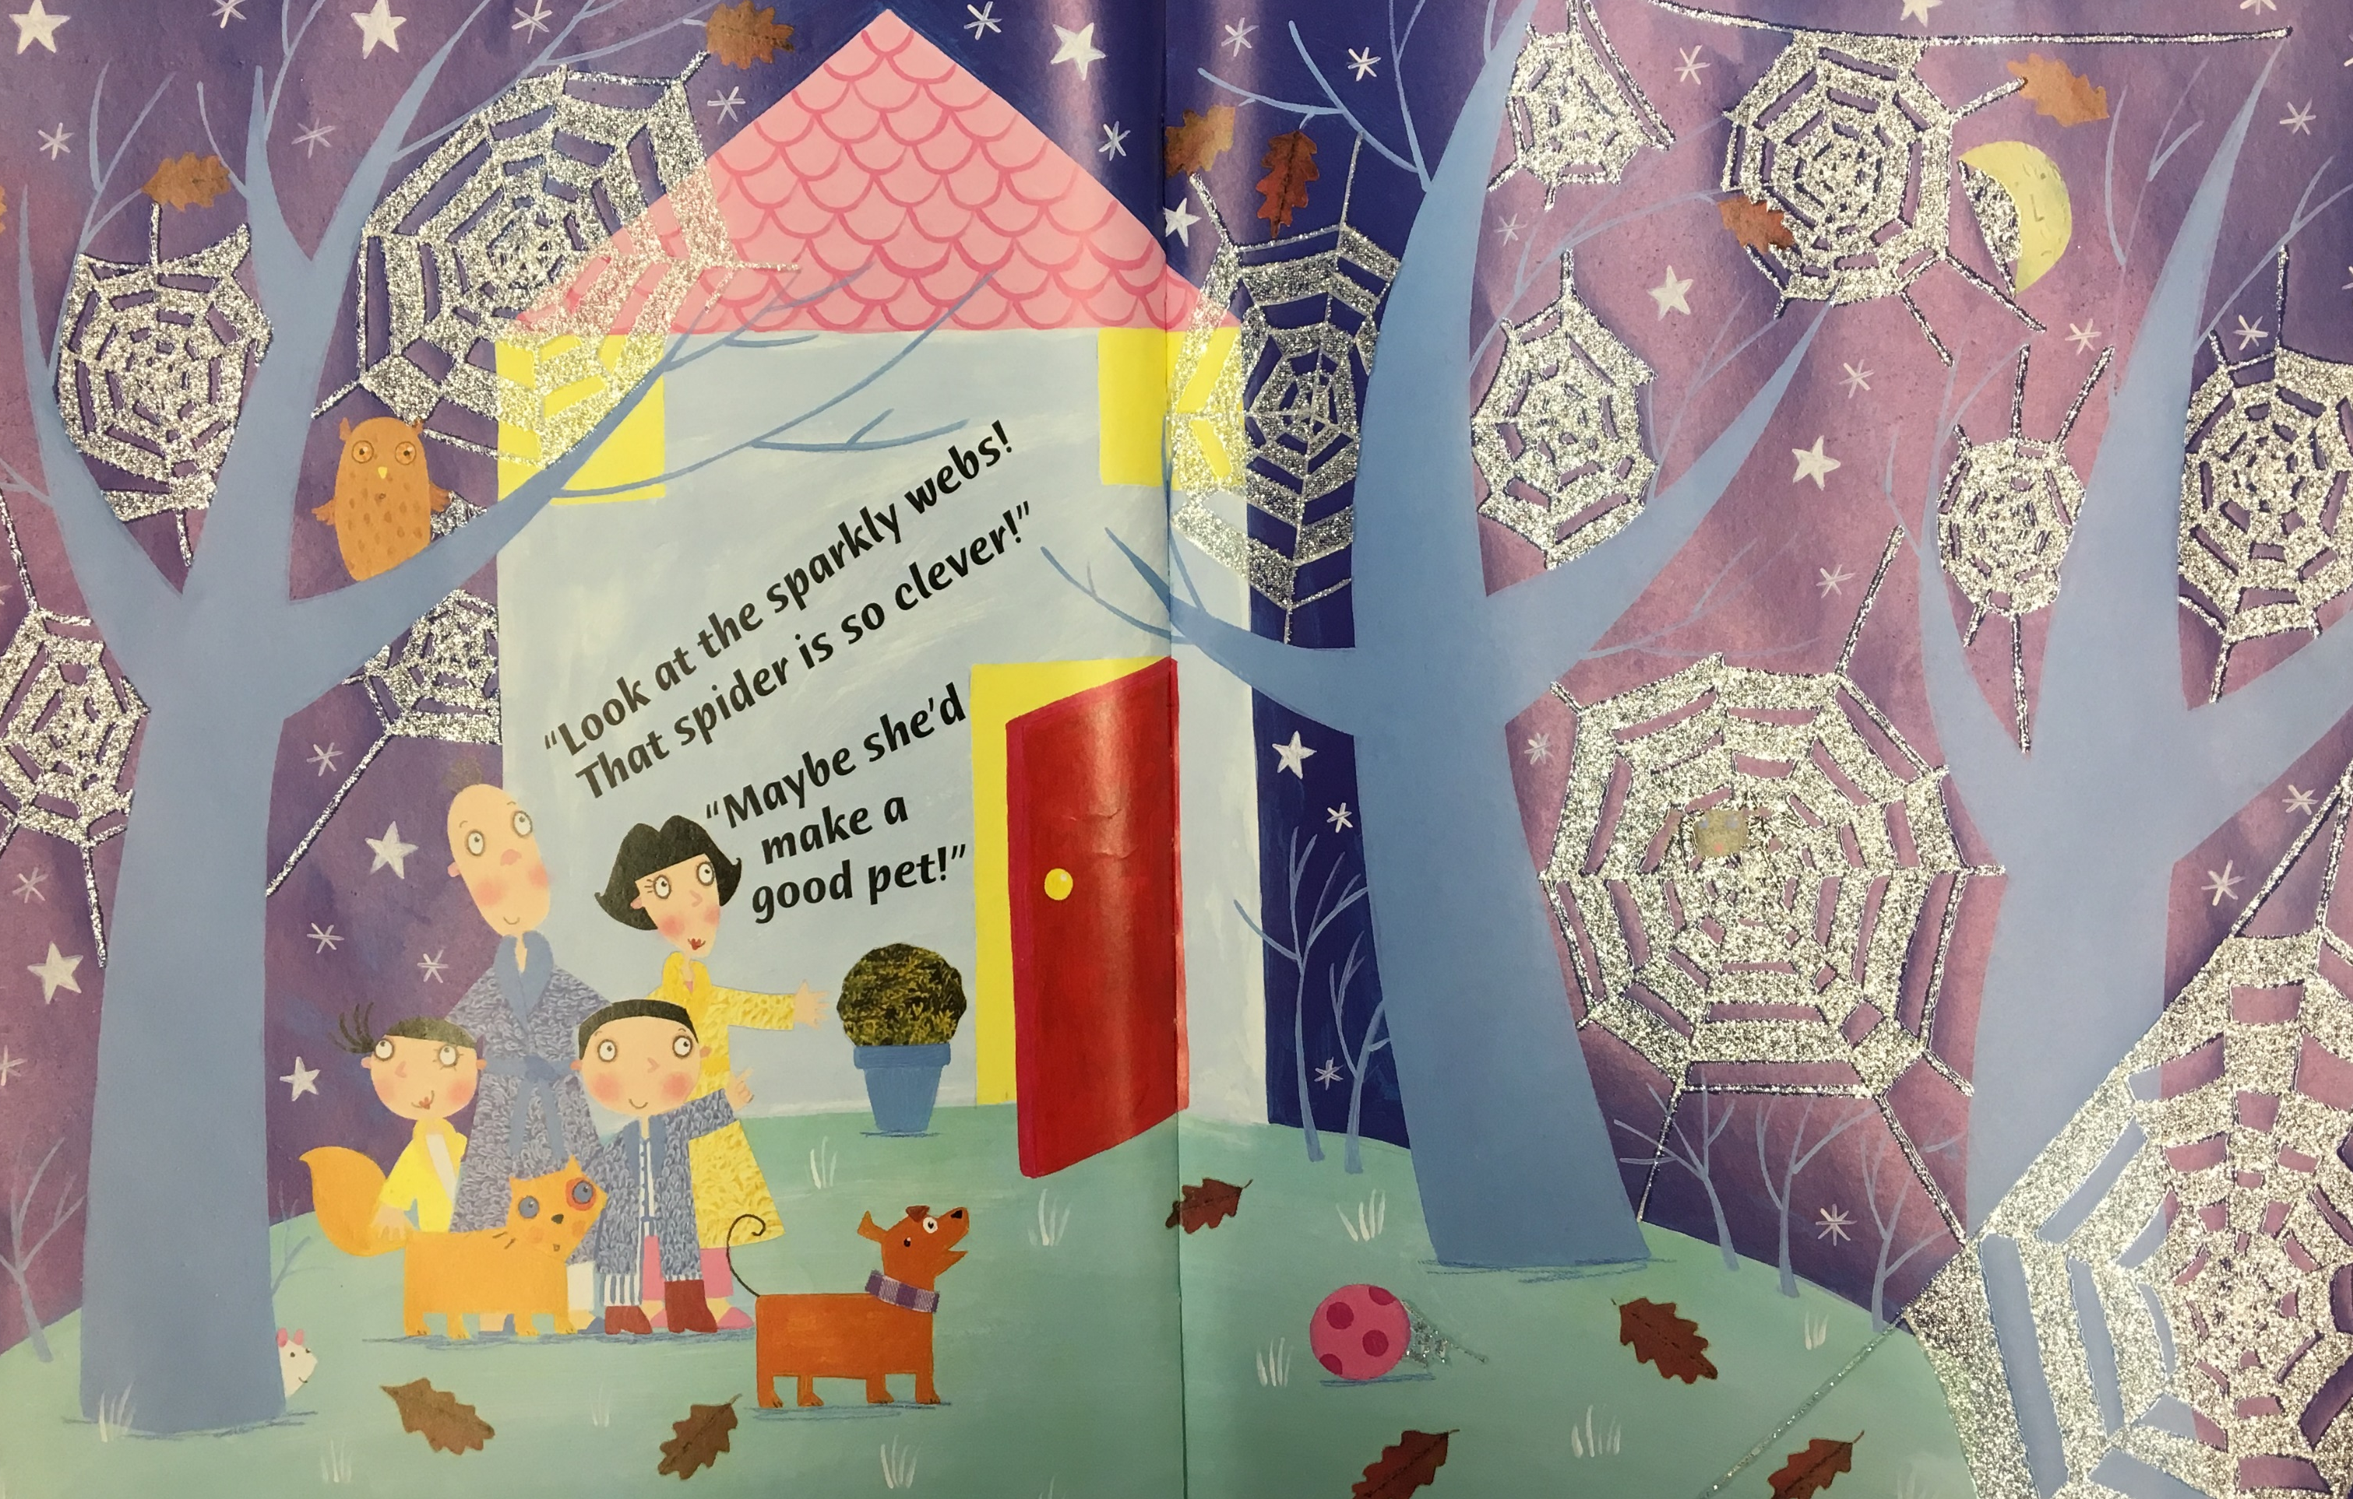
The spider now lived in a garden.
A few days later, the family discovered…
…the new sparkly spider webs.
…many more spiders.
A
B

Slide 14
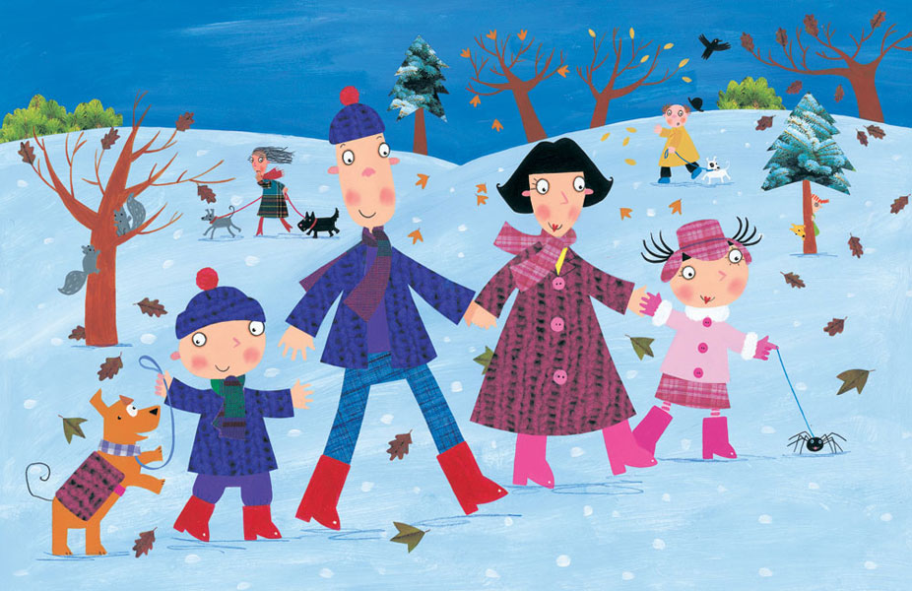
The spider is so…
… that it wants to show his new family to all his spider friends.
happy
sad

Slide 15
Oh dear!
You are wrong.
Go back and read again.
Go back!

